Slide 1

CSDS 451
Practice 1 - CWRU HPC & PyTorch
09/05/2024
By Changxin Li
Acknowledgement by Nat Tomczak
https://pytorch.org/

Slide 2
Important
Programming Assignment #0 → September 5th, 2024.
Follow instructions, you can double check and resubmit.
Writing Assignment #1 → Will be assigned today.

Slide 3
Outline
You’ll learn how to:
Access CWRU’s HPC
Use the module system
Create your own Python virtual environment
Run programs using HPC
Use Tensors in PyTorch
Create a basic model in PyTorch

Slide 4
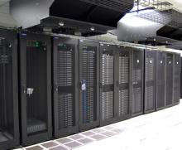
CWRU HPC
Resource managed by U-Tech
Offers:
Cloud storage
7,000+ processors
60+ GPU nodes
Runs Red Hat Linux (either 7/8)
Little global customization
You will be tied to Professor Kuppannagari’s account for this course
https://case.edu/utech/departments/research-computing/services\
https://sites.google.com/a/case.edu/hpcc/

Slide 5
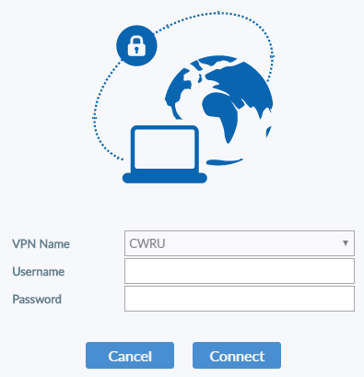
Accessing The HPC
SSH (most OSes have a client pre-installed)
You will need to use a VPN (e.g. FortiClient)
Or be on campus.
Open a terminal of your choice
Type the following:
ssh <CaseID>@<Cluster>.case.edu
If prompted on whether or not you wish to access the system, input “yes”
Input your password
You should now be connected to one of the clusters:
Markov
Pioneer
Rider

Slide 6
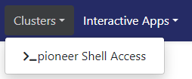
Accessing The HPC - Continued
OnDemand
Sign in to either of the following (server-dependent) to access the HPC:
https://ondemand.case.edu/
https://ondemand-pioneer.case.edu/
Hover over the “Clusters” tab and choose the shell specific to the server that you wish to access.

Slide 7
Controlling Node Resources
You can check resource usage here:
https://sites.google.com/a/case.edu/hpcc/hpc-cluster/hardware/cluster-resources
In order to allocate yourself a single node with specific resource amounts, enter the following in your terminal once you’ve accessed the server:
The following is one command
srun -A <Account> -p <Partition> --gpus=<GPU#>
-c <Core#> --mem=<Memory#><Unit> --pty /bin/bash
-A sxk1942_csds451 → Ready
CPU example:
srun -A sxk1942_csds451 -p markov_cpu -c 4 --mem=32gb --pty bash
srun -A sxk1942_csds451 -p markov_gpu --gres=gpu:1 --pty bash
“Ctrl + d” will allow you to exit your environment and disconnect from the node.
Repeat again to disconnect from the HPC.
exit and logout also work.

Slide 8

Commands To Navigate A Terminal With The Bash Shell
You should automatically have a Bash shell environment
Common commands to navigate using the command line:
pwd
ls
cd
touch
mkdir
rm
rmdir
vi (or vim)
cat

Slide 9
Lmod - Environment Modules
Lmod is a system that allows you to customize your environment (packages, compilers, etc.).
Commands:
module list
List the modules already loaded.
module avail
List all available modules.
module load
Load a specific module.
module unload
Unload a specific module.
module spider
Loadable modules/information.

Slide 10

Setting Up A Python Virtual Environment
We will be using the built in virtual environment for this tutorial, but you may use miniconda if you prefer it for package management.
We’ll begin by loading our desired version of Python using the module system.
module load Python/3.xx.xx
You must do this each time before activating your environment.
Check your version with the following:
python3 --version
Create a virtual environment with:
python3 -m venv <Path>\<VEnvName>
https://docs.conda.io/en/latest/

Slide 11

Activating And Maintaining Your Virtual Environment
After loading your Python module, enter the following:
source <PATH>/<VEnvName>/bin/activate
You can exit the virtual environment using:
deactivate
Once activated:
pip list
This will show you all python packages that are available.
In order to install more:
pip install <PackageName>
It is best to look up a package and check the current version to see if it is compatible with your version of Python.
If not, find the specific version and specify it within your install command.
https://www.python.org/

Slide 12
Introduction To PyTorch
PyTorch is a Python frontend to the Torch library.
Machine learning framework.
Developed by Meta and first released in 2016.
Now governed by the PyTorch Foundation (under the Linux Foundation).
Used by many major companies including Tesla and Uber.
Can be used by only CPU hardware:
Is compatible with accelerators:
GPU
TPU
https://pytorch.org/

Slide 13
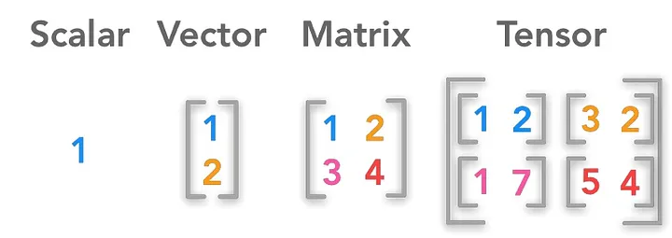
Tensors
Tensors are the most basic class within PyTorch.
You can do basic operations.
There is even an auto gradient feature.
This is very useful for deep learning.
A tensor is an N-dimensional object that operates as a multilinear map.
https://furkangulsen.medium.com/what-is-a-tensor-ce8e78835d08

Slide 14
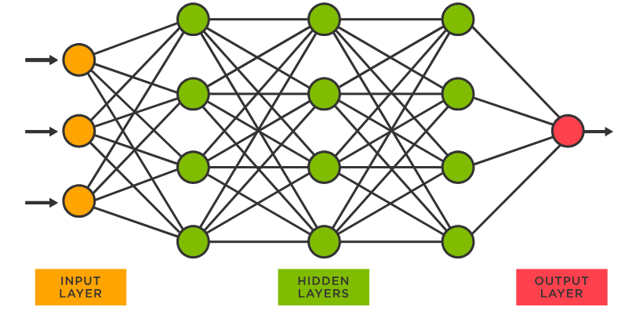
From Tensors To Neural Networks
What is a neural network?
https://www.tibco.com/reference-center/what-is-a-neural-network

Slide 15
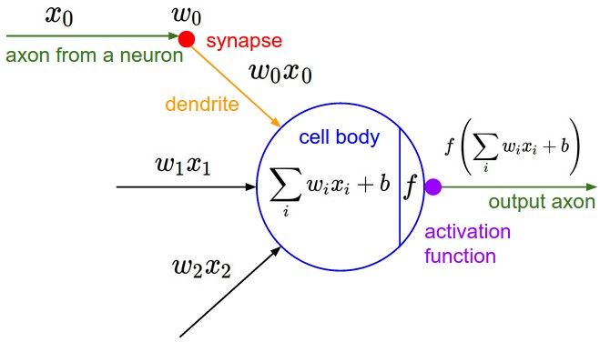
From Tensors To Neural Networks - Continued
We know that a layer of a fully-connected neural network can be written as:
https://www.cs.toronto.edu/~lczhang/360/lec/w02/terms.html

Slide 16
From Tensors To Neural Networks - Continued
This means that we can translate the connected image to a mathematical operation:
Fully-connected layers (minus the bias and activation function) are simply matrix multiplications.
Other types of layers are more complex, but they are just mapping the input tensor to new vector spaces.
This is the basis for machine learning.
W
X
●
=
W X
●

Slide 17
Resources
CWRU HPC: https://sites.google.com/a/case.edu/hpcc/
PyTorch & Deep Learning: https://pytorch.org/tutorials/beginner/deep_learning_60min_blitz.html
Neural Networks: https://www.youtube.com/watch?v=aircAruvnKk&themeRefresh=1

